Slide 1
©️Naimul Islam Mehedi
Module 1: Introduction to Cybersecurity (Brief Overview)
Defining Cybersecurity: Threats, vulnerabilities, and assets.
The CIA Triad: Confidentiality, Integrity, Availability.
Types of Cyberattacks: Malware, phishing, DDoS, etc.
Introduction to Ethical Hacking: Definition, scope, and importance.
Legal and Ethical Considerations in Cybersecurity.
Different Roles in Cybersecurity: Security Analyst, Penetration Tester, Security Engineer, etc.

Slide 2
Defining Cybersecurity: Threats, vulnerabilities, and assets.

Slide 3
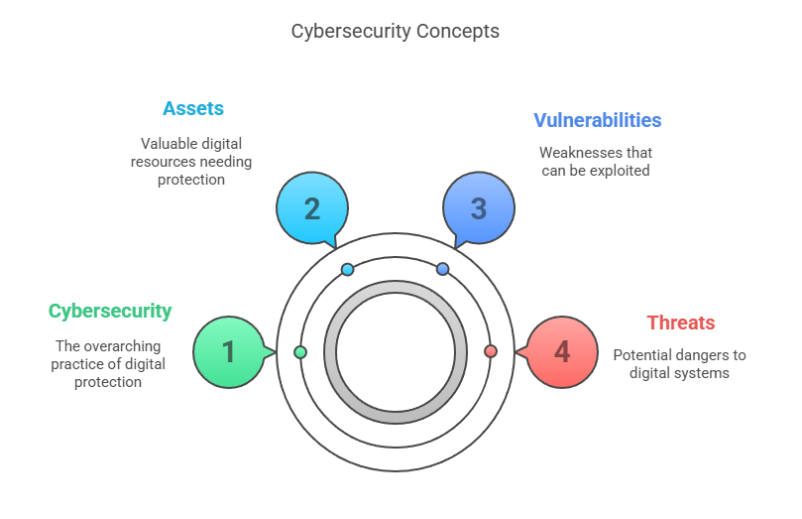
©️Naimul Islam Mehedi

Slide 4
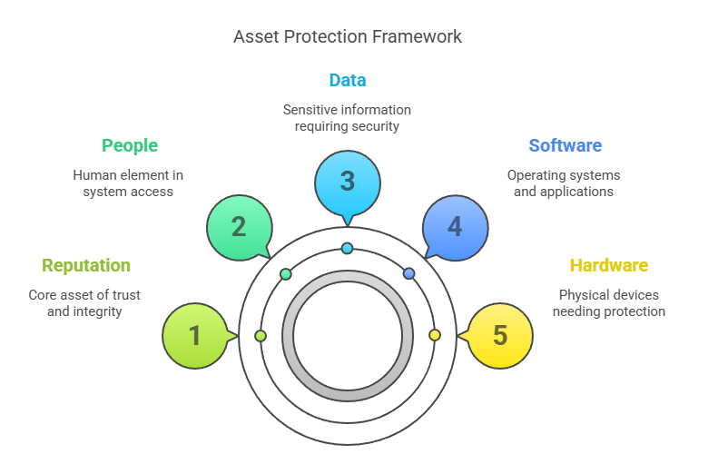
©️Naimul Islam Mehedi

Slide 5
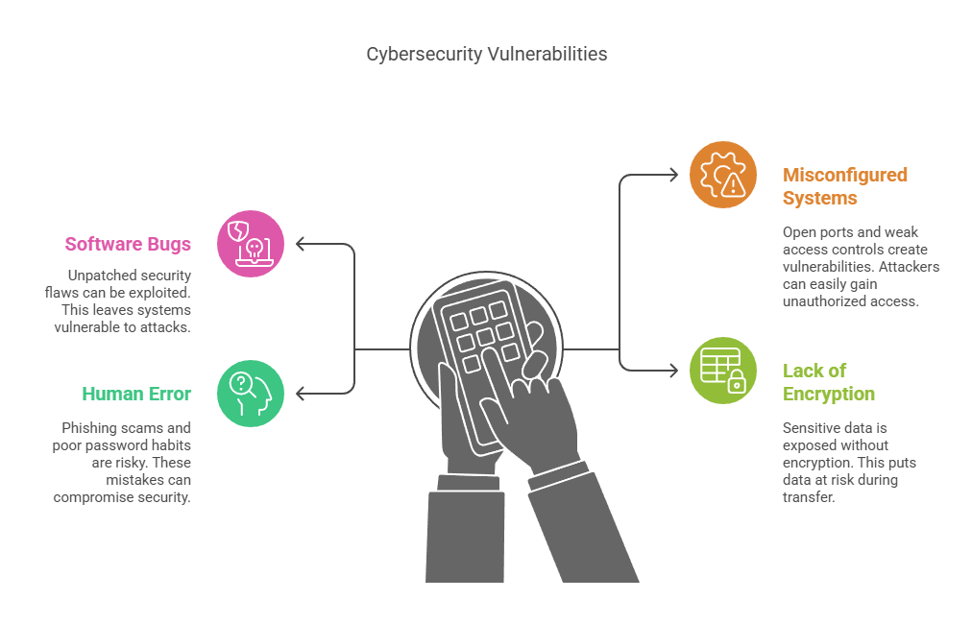
©️Naimul Islam Mehedi

Slide 6
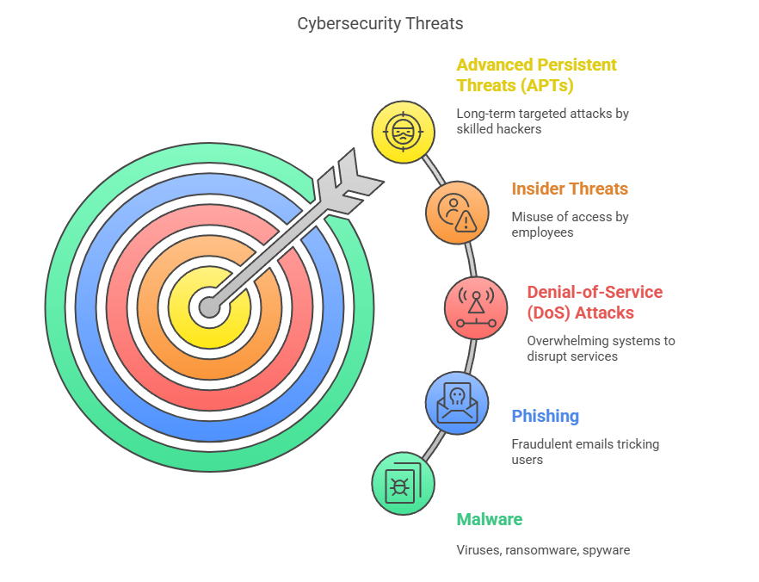
©️Naimul Islam Mehedi

Slide 7
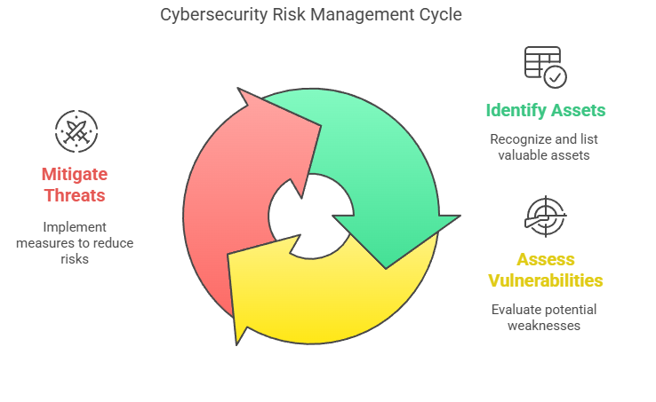
Threat actors (hackers, cybercriminals) look for vulnerabilities to exploit in assets.
Effective cybersecurity involves risk management: identifying assets, assessing vulnerabilities, and mitigating threats.
©️Naimul Islam Mehedi

Slide 8
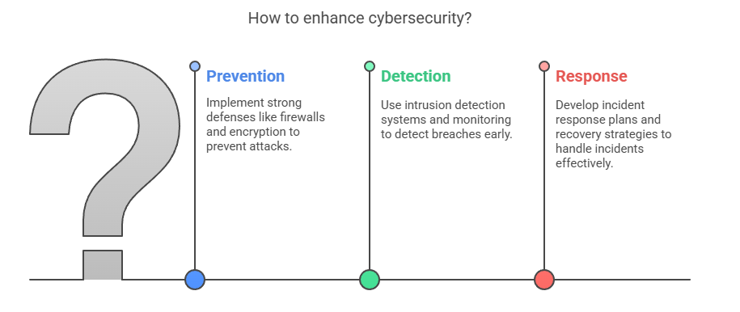
Key Goal of Cybersecurity
To protect confidentiality, integrity, and availability (CIA Triad) of assets by:
Preventing attacks through strong defenses (firewalls, encryption).
Detecting breaches early (intrusion detection systems, monitoring).
Responding to incidents (incident response plans, recovery strategies).
©️Naimul Islam Mehedi

Slide 9
The CIA Triad: Confidentiality, Integrity, Availability.

Slide 10
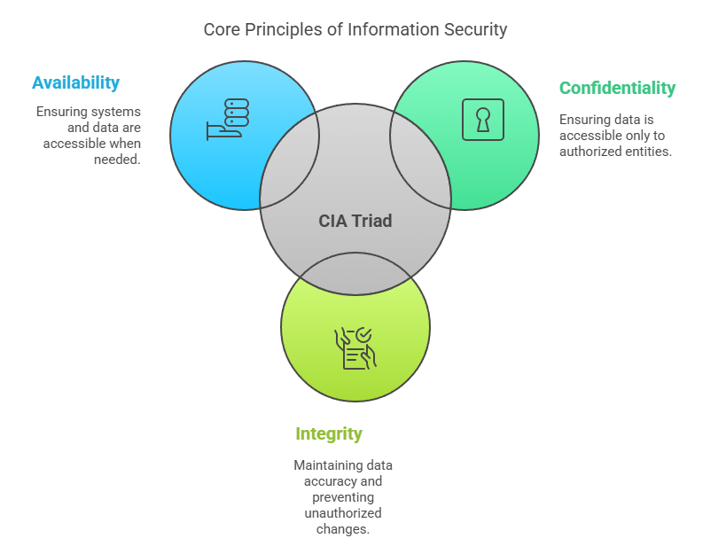
©️Naimul Islam Mehedi

Slide 11
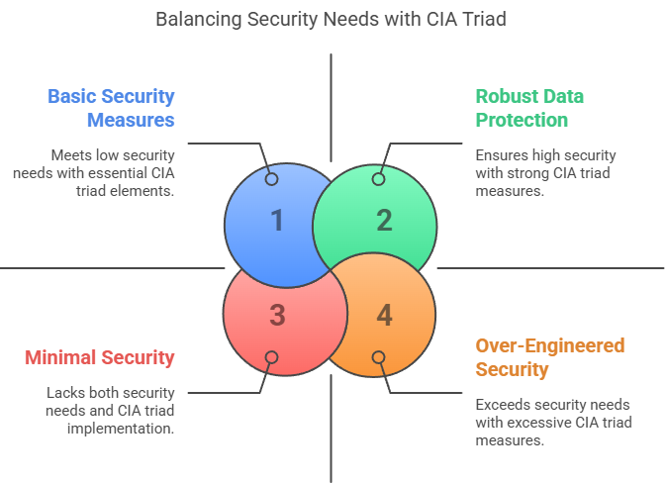
©️Naimul Islam Mehedi

Slide 12
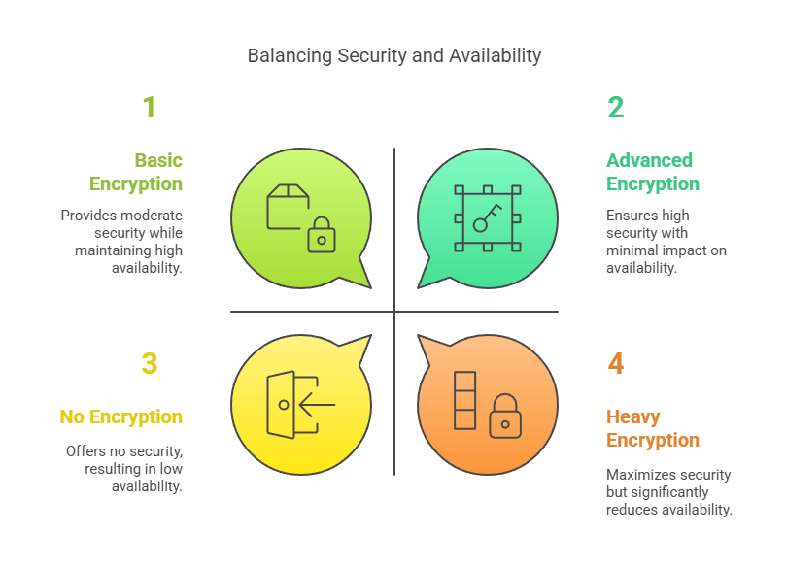
©️Naimul Islam Mehedi

Slide 13
Types of Cyberattacks

Slide 14
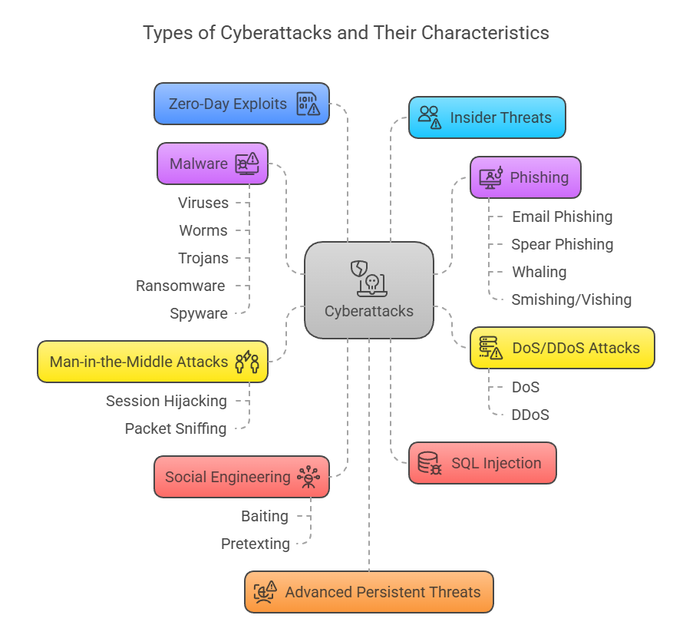
©️Naimul Islam Mehedi

Slide 15
Prevention Measures:
Use strong passwords + multi-factor authentication (MFA).
Keep software updated (patches).
Educate users on phishing/social engineering.
Deploy firewalls, antivirus, and intrusion detection systems (IDS).
Regular backups (to counter ransomware).
©️Naimul Islam Mehedi

Slide 16
Introduction to Ethical Hacking: Definition, scope, and importance.

Slide 17
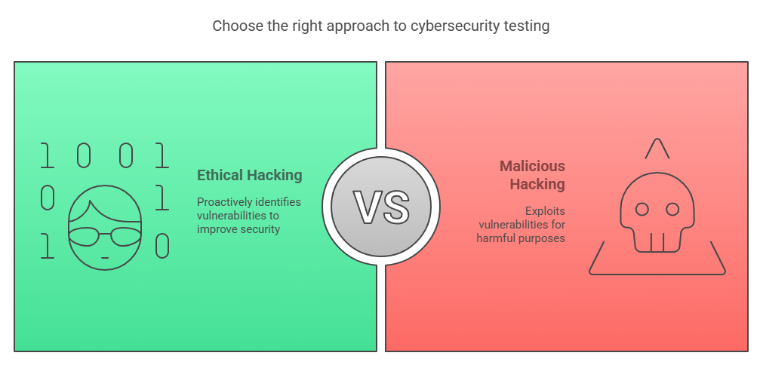
Ethical hacking (also known as penetration testing or white-hat hacking) is the authorized practice of bypassing system security to identify potential vulnerabilities that malicious hackers (black-hat hackers) could exploit. Ethical hackers use the same techniques as cybercriminals but with permission to improve security rather than cause harm.
Key Characteristics of Ethical Hacking:
Legal & Authorized – Conducted with explicit permission.
Goal-Oriented – Aims to strengthen security, not damage systems.
Follows a Code of Ethics – Adheres to professional and legal standards.
©️Naimul Islam Mehedi

Slide 18
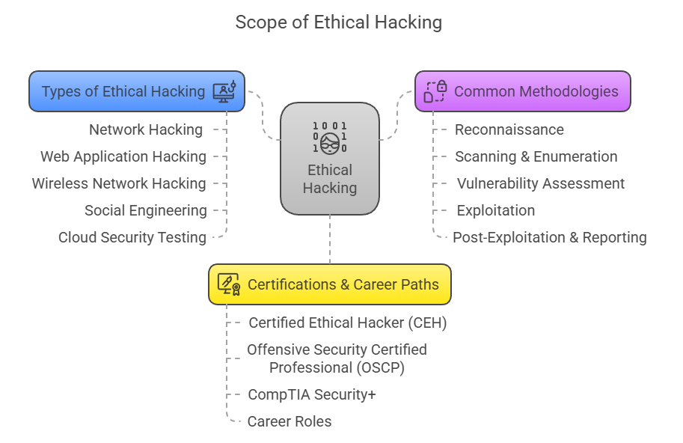
©️Naimul Islam Mehedi

Slide 19
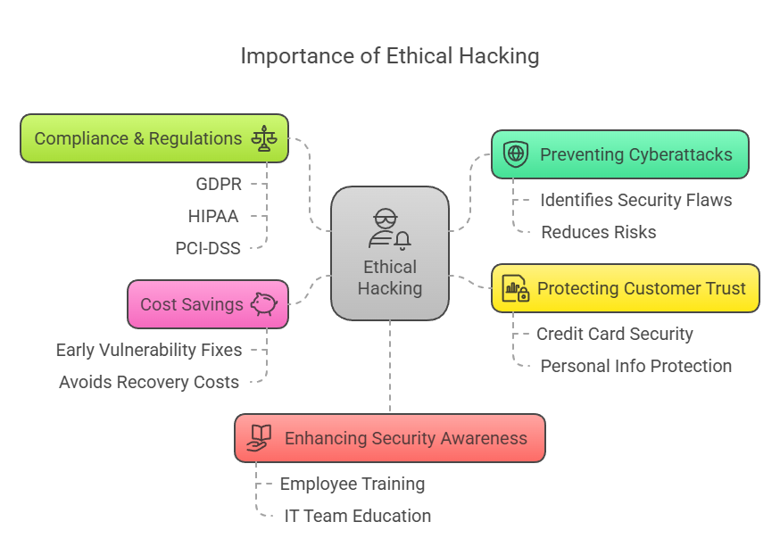
©️Naimul Islam Mehedi

Slide 20
Legal and Ethical Considerations in Cybersecurity.

Slide 21
©️Naimul Islam Mehedi

Slide 22
Different Roles in Cybersecurity: Security Analyst, Penetration Tester, Security Engineer, etc.

Slide 23
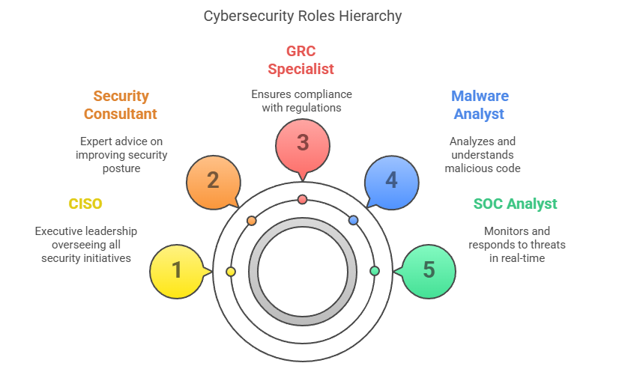
©️Naimul Islam Mehedi

Slide 24
©️Naimul Islam Mehedi

